Slide 1

- Final Presentation -

Slide 2

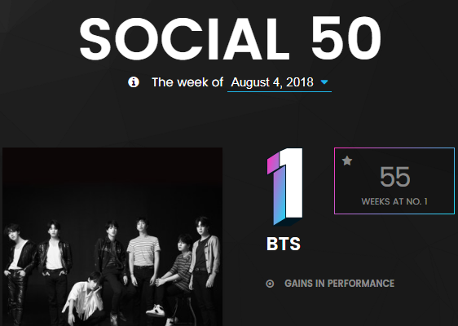



Who is BTS?
More Fabulous than Kimchi and Psy (Gangnam Style)
The group's 2018 album, LOVE YOURSELF 轉 'Tear', debuted at No. 1 on the Billboard200
and No. 10 on the BillboardHOT100 , marking the highest rank as Asian artist in history
2017 and 2018 Billboard Music Awards BBMAs - Top Social Artist
Current No.1 in Social 50 chart (https://www.billboard.com/charts/social-50)

Slide 3

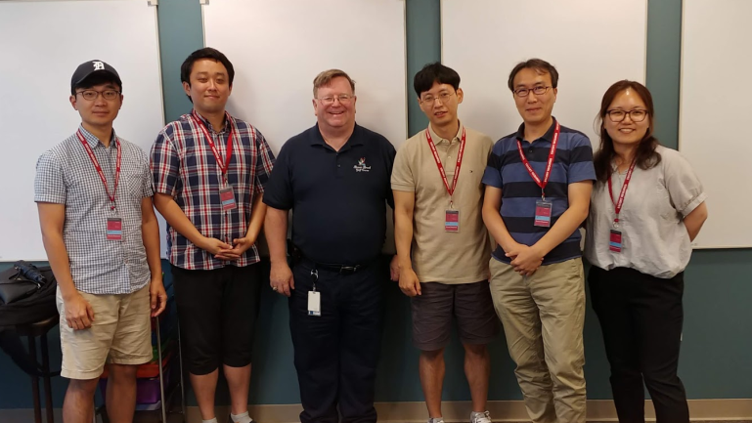
Team introductions
Team Goal
“Understanding of SDET Culture and Techniques”,
not dancing or singing like BTS.
Team member / Main Role
Clifford C Huff / Mentor
Sungho Chin / Team & Project Lead
Jonggoo Lee / Code Review Lead
Sujung Lyu / Refactoring Lead
Jinhyuk Yang / Static Analysis Lead
Hyoyeon Hwang / Plan & Test Lead
Ground Rules
Every member should be involved in every quality management process.
5hrs for project / day, 1 project meeting / day, 1 mentoring meeting / week

Slide 4
Project introductions
프로젝트 goal 변경
Quality goal 을 정의
Measure 정의
이C
Project Goal
Making Bug-free Game. (at least No Major, Critical defects)
Focus on testability
not focus on simple coverage ratio
Quality Goals
Testability : line coverage : 90%, branch coverage : 80%, mutation coverage : 90%
Function’s Logical Correctness : Unit Test - pass 100%
Function’s suitability for new features : 60%
Usability (optional) : improve game command and message visibility (can be play the game with the less use ‘help’ command)
Discussion of collected data : team Wiki, JIRA, Sonar, GIthub
프로젝트 goal(quality goal 포함)
목표대비/달성도 비교 추가
Quality activity 의 경험하고 현업에 적용
System test case 추가
개발 feature 를 세분화하고 pass율 작성
비기능 – 서버 동시 접속 내구성 테스트

Slide 5
Project Risk Management (to be edited)
황S
Project Risk
Technical Risk
- Unclear requirements make implementation and source modification difficult :
Modify and add requirements to clarify.
- skill level of java language among individual : assign job by individual skill level
Resource Risk
- Lack of time to implement new feature : separate members into developers and testers based on their specialities.
- difficult to select appropriate project management tools : Using external JIRA tools that team members feel familiar.
Product Risk
Product Quality Risk
Many unintended errors occurred during the integration of new functions : Simultaneously execute integration test and system test.

Slide 6
Project Results - Quality activities
유C
용어 기준
Code Review
Team (Technical) Review
Static Analysis
SonarQube
Refactoring & Rework
Static Analysis
Unit Test / Mutation Test
White Box testing (statement testing, branch testing)
JUnit4, Mockito, jacoco, PITest
Integration Test
Scenario testing (Black box testing)
JUnit4, Mockito, jacoco
System Test
Scenario testing, Ad-hoc testing, Combination testing, Boundary Value Analysis

Slide 7

Project Plan

Slide 8
Project efforts
efforts for Project
Planned effort : initial planned effort(h) for our project
Estimated effort : estimated effort(h) for each task by assignee
Actual effort : actual executed effort(h) for each task

Slide 9
Project Results - Defect Categorization
이C
Definition of Severity
Severity | Category | Defect Types
Critical | Functionality | Conflict to requirements
 | Reliability | Cirtical unstable issue. (can't proceed game)
Major | Maintainablity | Structural Odd Code (no consistant with other code)
 | Maintainablity | Static Analysis critical issue
 | Reliability | Memory handling issue
 | Functionality | Strange functional Operation
Minor | all defects except Critical, Major defect
Severity 정의
Lessen & learned.(?)
- 각 단계별로 severity 를 다르게 정의해야 하는가
Not Actual Data

Slide 10
Project Results - Defect Categorization
이C
Not Actual Data
- 단계별-severity 데이터 합치기
- 단계별 effort
Method / Tool with Severity
Lesson learn 추가
Defect 찾는 효율

Slide 11
Quality activities - Code Review
유C
Goal
Understanding system of Tartan Adventure.
checking correspondence between Spec. and Code
detecting Code defect
Resource
Planned Effort: (6/21 ~ 26) 50h (2h * 5days * 5 members)
Actual Effort : 36.5h
Outputs
number of Defects : 21
Lessons Learned
Vague requirements made code review hard.
Code review is one of good way to understanding System.
숫자 현행화
Lesson & learned.수정
표 교체

Slide 12
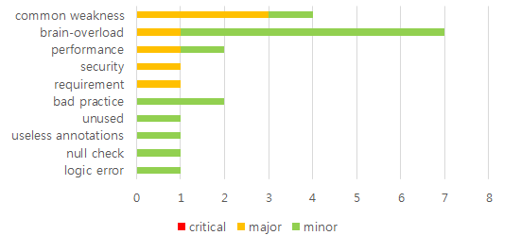
Quality activities – Static analysis
양S
Goal
To detect defects with less effort than dynamic testing
To integrate static analysis tools to the CI environment
Resource
Planned Effort: (6/21 ~ 26) 50h (2h * 5days * 5 members)
Actual Effort : 36.5h
Outputs
Number of Defects : 88 (major : 6, minor: 82)
Lessons Learned
Static analysis result is used as a basic data of refactoring.
It helped to manage coding convention and complexity.
리소스 업데이트
Defect category
업데이트

Slide 13
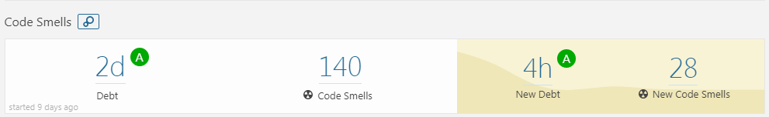
Quality activities - Refactoring & Re-Work
양S
Goal
Improving Testability
Improving Code smells in SonarQube (by 1day debt)
Resource
Planned Effort: (7/9 ~ 13) 50h (2h * 5days * all members)
Actual Effort : 31h
Outputs
Refactoring status : number of refactoring items (69) (ref. appendix.1)
SonarQube trend: (ref. appendix.2)
Lessons Learned
Refactoring is indispensable for Testability
Monitoring method for Field Status is needed to know changed status.
- For this, We discussed for changing private fields to public fields
- Finally, we added getter & setter methods.
Method should return about that’s result of procedure.
리소스 업데이트
SonarQube code smell 업데이트

Slide 14
Quality activity – Unit Test
양S
Goal
Verify the operation for function
Satisfying code coverage
Completion criteria
Unit Test – pass rate : 100%
90% statement / 80% branch coverage
Resource
Planned Effort : 45h (7/16~20, 3 hours a day, all members)
Actual / estimated Effort : 64h/73h
Outputs (ref. appendix.4)
Number of Unit Test : 241 => Number of Defects : 6 (critical : 3 , major : 3)
Coverage : statement coverage : 88%, branch coverage : 85%
Lessons Learned
Should simple code be included in the Unit test?
→ Our team's decision: don’t include
To effectively write the Unit test, we need a detailed specification.
Less defect is found as it progresses to code coverage rather than verifying function operation
유닛 테스트 과정에서 좀 더 있는 코드 리뷰가 가능해서 코드의 품질을 올려서 defect 이 적었다.
리소스 업데이트
Unit test 개수 업데이트
Coverage 결과 업데이트

Slide 15
Quality activity – Mutation Test (added)
황S
Goal : Satisfying Mutation coverage
Goal Coverage
80% line coverage 80% mutation coverage
Resource
Planned Effort : 5h (7/23, 1 member, 5 hours)
Estimated Effort : 10h (7/23, 2 members, each 5hours)
Actual : 11h (7/23 , 2 members, 6hours + 5hours )
Outputs (ref. appendix.5)
affected Unit Test Case : GameTest.java - 46 , ItemTest - 3, PlayerTest.java - 4
Mutation Test Result Report (PIT Summary)
Mutation coverage : 55 -> 71.3 % for Game, Player, Item classes
Lessons Learned
Improvement of Mutation coverage was not directly related to improvement of Unit Test defect detection. → selectively handle the remaining test case bugs provided by the PIT.
explicit unit test case implementation of the parts to be checked and the degree of stub processing affected the mutation coverage.
The purpose of the mutation test is to check the fidelity of the test case.
test case verification of programs that contain a lot of logic to change the value
test case verification of safety-oriented programs (automotive, aviation-related programs, etc.).
we did mutation test before implement new feature
Notes:
예상 질문
유닛테스트 작성을 위해 디테일한 스펙을 정리 했는가?

Slide 16
Quality activity – Integration test (To be edited)
황S
Goal : Merge the new features into one repository and verify that they are working properly.
Completion criteria
Test case result : 100% pass
Resource
Planned Effort : 45h (7/18~20, 2hours a day, all members) -> 19h 30m
Actual Effort : 15h 40m
Outputs
Test case : 11 (ref. appendix.5 )
pass rate : : 100 %
Defect list : 1 (SDET-46) (appendix. 5)
Lessons Learned
In the tartan project, the modules are already integrated, should we do the integration test?
New feature integration test case 및 defect 기준으로 수정
New feature 내용 위주로 재구성
기존 내용은 effort. 관련된 데이터 위주로 재사용
Notes:
예상 질문

Slide 17
Quality activity - System test
유C
Goals
Verify requirements from the user's perspective.
Especially, Use-Cases will be mainly validated.
Completion criteria
Test case pass rate : 100%
Resource
Planned Effort : 40 hours (4Cycle / 5 hours per dycle / 2 members)
Actual Effort : 35
Outputs
Test case : 492(appendix. 7)
Current pass rate : 100 %
Defect list : 30 (appendix. 5)
Lessons Learned
Ambiguous requirements and unexpected gaming behavior made code review hard.
Output 정리 필요
진행중
Scenario : 29, Action/Item : 434, Game Config. : 29
시나리오 : palyer와 designer의 시나리오 흐름도를 기반으로
시나리오의 시작에서 종료까지 path를 타도록 TC를 생성
Action/Item : 게임 진행시 필요한 세부 동작에 대한 test case. 모든 아이템(29개)의 action(14)을 실행하고, 추가로 item 없는 action에 대해서도 test하기 위한 tc 생성
Game Config. : designer의 시나리오과 관련 있음. 디자이너가 만든 게임의 valid 를 check 하는것에 대한 세부 TestCase를 분리한것.
진행중

Slide 18
New Feature Architecture
Msgs & cmds
msgs & cmds for offline
New modules
msgs & cmds for online
user
Game Config Json
Offline
User
online
User
Game Config Json
Tartan Terminal
Game Config Json
Socket
Game
Process
System.in & out
Tartan Server
Custom Game
User DB
Socket
System.out
System.in
Socket
User Management
Socket
Game
Game
Tartan Client
Player
Save Json
Save&Load
Player
Game Configuration
Custom Game Configuration
Room
Item
Room
Item
Game Thread

Slide 19
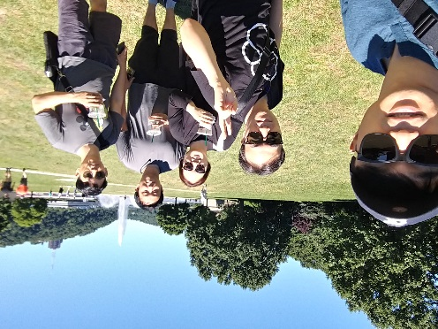
Course Lesson & Learned
“I got the idea that quality activities could be more enjoyable than development.”– Sungho chin
~~~~ – Sujung Lyu
It was a good time to experience the work of the test engineer while we were working on the project. As a test manager, I will try to apply what I learned in this course to my work. – Hyoyeon Hwang
~~ – Jinhyuk Yang
~~~~ – Jonggoo Lee

Slide 20
Q&A
Thank you for your attention!!

Slide 21
Tools
CI : Github + Jenkins (http://18.210.196.163:8080)+ sonaQube
Source repository : github (https://github.com/sunghochin/TartanAdventure)
Quality Tool : SonarQube (http://18.210.196.163:9000/projects)
document configuration : wiki page (https://sdet-bts.atlassian.net/wiki/spaces/SDET/overview)
issue tracker : jira (https://sdet-bts.atlassian.net/secure/RapidBoard.jspa?projectKey=SDET&rapidView=1)
Coverage library : jacoco, pitest
Auto trigger build
Static analysis
build
Coverage integration
source commit
Measure coverage

Slide 22
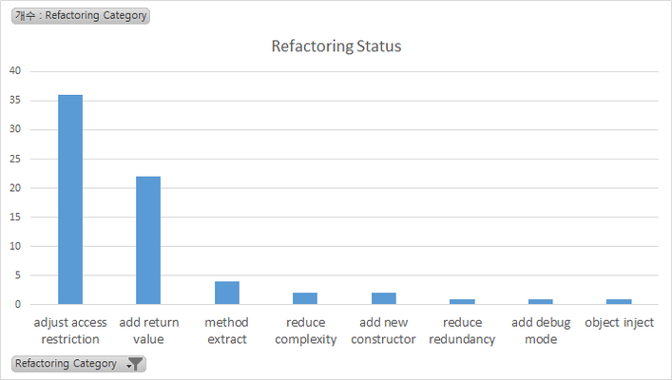
Appendix 1. Refactoring & Re-Work
Refactoring Status
Category | num | Graph
adjust access restriction | 36
add return value | 22
method extract | 4
reduce complexity | 2
add new constructor | 2
reduce redundancy | 1
add debug mode | 1
object inject | 1

Slide 23
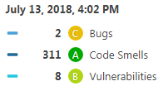
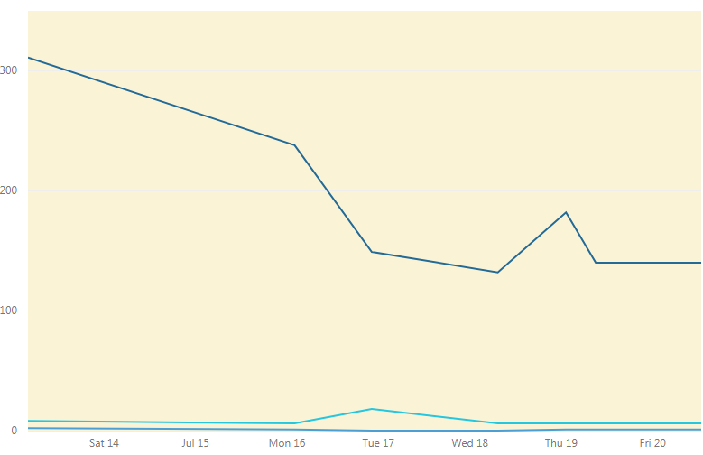
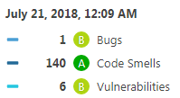
Appendix 2. Refactoring & Re-Work
SonarQube Trand

Slide 24
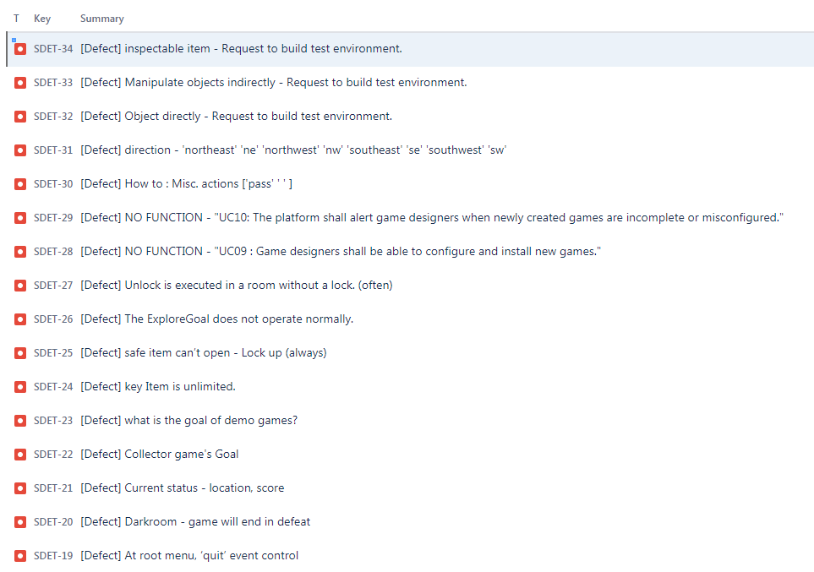
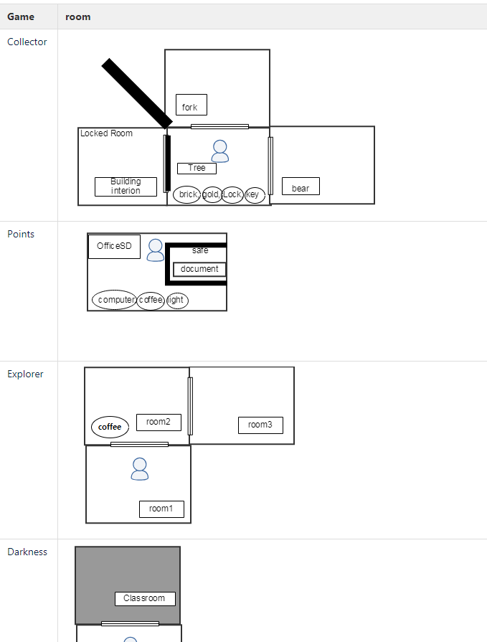
Appendix 3. Pre-Test outputs
Defect : 16
Game Map

Slide 25
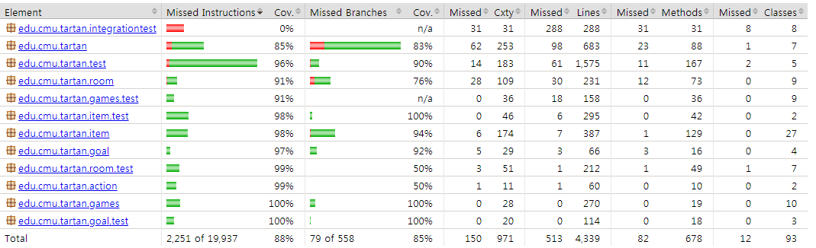
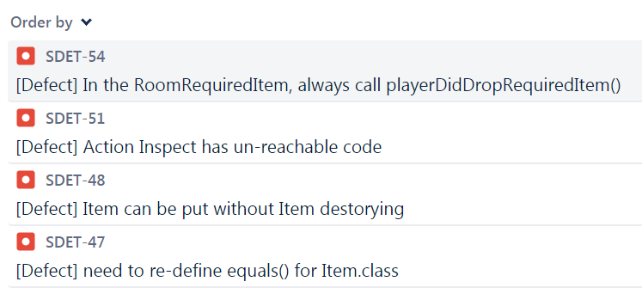
Appendix 4. Quality activity – Unit test
Coverage
Defect list
Notes:
예상 질문
유닛테스트 작성을 위해 디테일한 스펙을 정리 했는가?

Slide 26
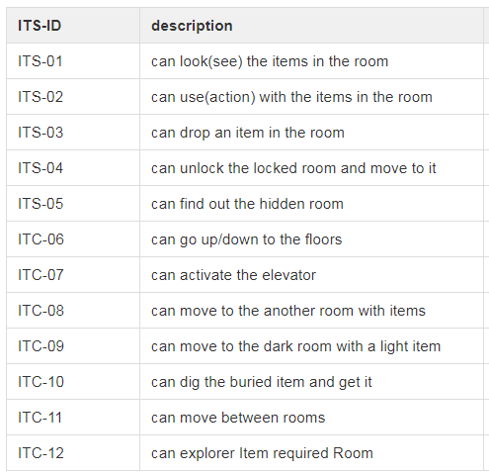
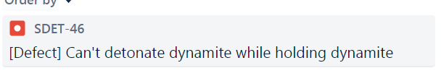
Appendix 5. Quality activity – Integration test
Test case
Defect list
Notes:
예상 질문

Slide 27
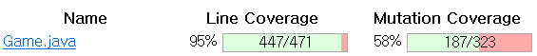
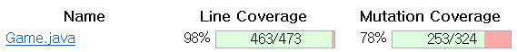
Appendix 4. Quality activity – integration test
Before Coverage
After Coverage
Notes:
예상 질문
유닛테스트 작성을 위해 디테일한 스펙을 정리 했는가?

Slide 28
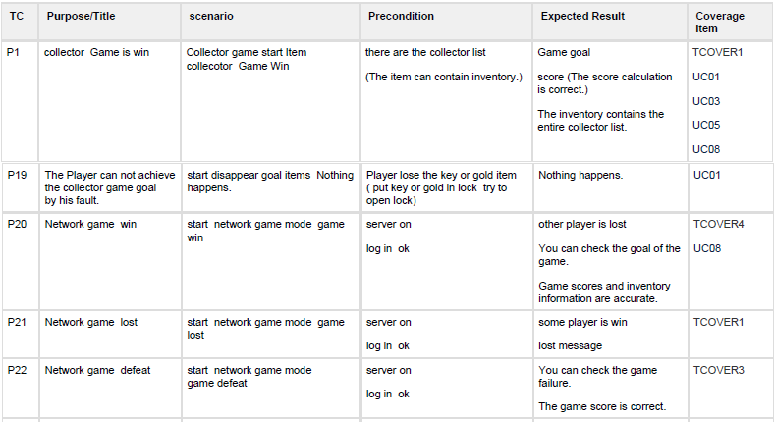
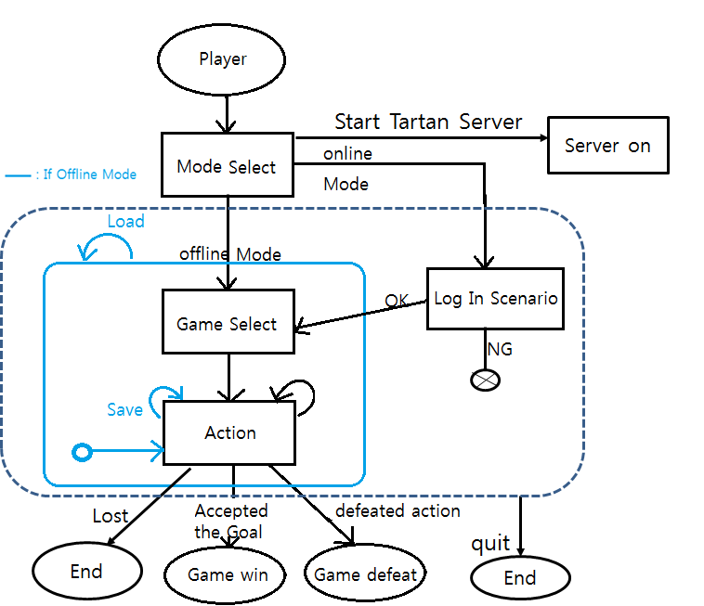
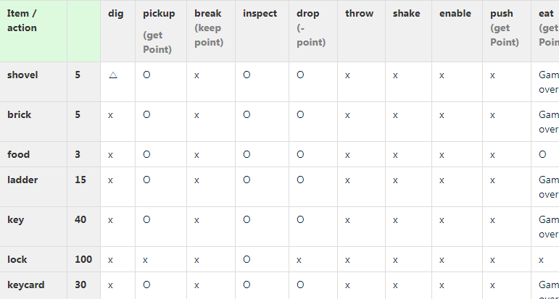
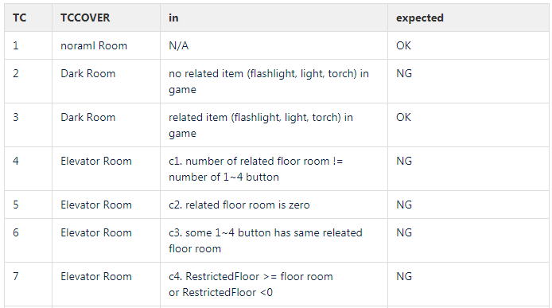
Appendix 7. Quality activity – System Test TC
Scenario
Action & Item
Game Config.
Notes:
예상 질문

